Slide 1
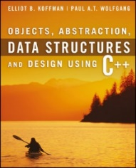
Welcome to
CS 235 Data Structures
Software Design, 1.1-4 (06)

Slide 2
Tip #06: Pointer Variable Declaration
Whenever something can be done in two ways, someone will be confused; whenever something is a matter of taste, discussions can drag on forever.
// C Style
#include <stdio.h>
int *foo(int x, int *y, int **z)
{
*y = x;
++**z;
return y;
}
int main(int argc, char *argv[])
{
int a = 10;
int *b = &a;
int **c = &b;
printf("%d\n", *foo(a, b, c));
return 0;
}
// C++ Style
#include <iostream>
int* foo(int x, int* y, int** z)
{
*y = x;
++**z;
return y;
}
int main(int argc, char* argv[])
{
int a = 10;
int* b = &a;
int** c = &b;
std::cout << *foo(a, b, c) << std::endl;
return 0;
}
C++, on the other hand, has a heavy emphasis on data types.
A typical C++ programmer writes "int* y" and explains "y is a pointer to an int", emphasizing type.
Indeed, the type of y is int*.
C emphasizes expressions; declarations are often considered little more than a necessary evil.
A typical C programmer writes "int *y" and explains "*y is an int", emphasizing syntax.
Indeed, the * binds to the name y in the grammar.

Slide 3
Lab 01 - Grades

Slide 4
Lab 01 - Grades
Lab Description:
Read from a file a student's name followed by all their exam scores.
Calculate and write the average score for all students on each exam to an output file.
Write each student's name followed by the student's score and grade for each exam.
Guidelines
Use command line argument argv[1] and argv[2] to specify input/output file names.
The first line of the input file has # of students and scores followed by a line for each student and their exam scores.
Store student names in a dynamic one-dimensional array (no vectors).
Store exam scores in a dynamic two-dimensional array (one row for each student, one column for each exam score.) Again, use arrays and not vectors to store exam scores!
Calculate and output the average score for all students on each exam.
Output each student's name followed by the student's score and grade on each exam.
Use the average score for each exam to calculate and display the student's grade for that exam.
If the student's score is + or - 5 or less points of the average, give a grade of C.
If the grade is more than 5 points but less than 15 points above (or below) the average, give a grade of B (D).
If the grade is 15 points or more above (or below) the average, give a grade of A (E).

Slide 5
Grading
Input:
E
C
A
6 8
Cody Coder 84 100 100 70 100 80 100 65
Harry Houdini 77 68 65 100 96 100 86 100
Harry Potter 100 100 95 91 100 70 71 72
Mad Mulligun 88 96 100 90 93 100 100 100
George Washington 100 72 100 76 82 71 82 98
Abraham Lincoln 93 88 100 100 99 77 76 93
…70 75 80 85 90 95 100
D
Exam #6
Average
B
# of Students, # of Exams
Output:
Exam Averages:
Exam 1 average = 90.3 0(A) 2(B) 2(C) 2(D) 0(E)
Exam 2 average = 87.3 0(A) 3(B) 1(C) 0(D) 2(E)
Exam 3 average = 93.3 0(A) 4(B) 1(C) 0(D) 1(E)
Exam 4 average = 87.8 0(A) 2(B) 2(C) 1(D) 1(E)
Exam 5 average = 95.0 0(A) 0(B) 5(C) 1(D) 0(E)
Exam 6 average = 83.0 2(A) 0(B) 1(C) 3(D) 0(E)
Exam 7 average = 85.8 0(A) 2(B) 2(C) 2(D) 0(E)
Exam 8 average = 88.0 0(A) 3(B) 1(C) 0(D) 2(E)
Student Exam Grades:
Cody Coder 84(D) 100(B) 100(B) 70(E) 100(C) 80(C) 100(B) 65(E)
Harry Houdini 77(D) 68(E) 65(E) 100(B) 96(C) 100(A) 86(C) 100(B)
Harry Potter 100(B) 100(B) 95(C) 91(C) 100(C) 70(D) 71(D) 72(E)
Mad Mulligun 88(C) 96(B) 100(B) 90(C) 93(C) 100(A) 100(B) 100(B)
George Washington 100(B) 72(E) 100(B) 76(D) 82(D) 71(D) 82(C) 98(B)
Abraham Lincoln 93(C) 88(C) 100(B) 100(B) 99(C) 77(D) 76(D) 93(C)
Exam #6 Average = 83.0%
Cody's Score = 80% = C
Exam #6 Average = 83.0%
Exam #7 Average = 85.8%
Mad's Score = 100% = B

Slide 6
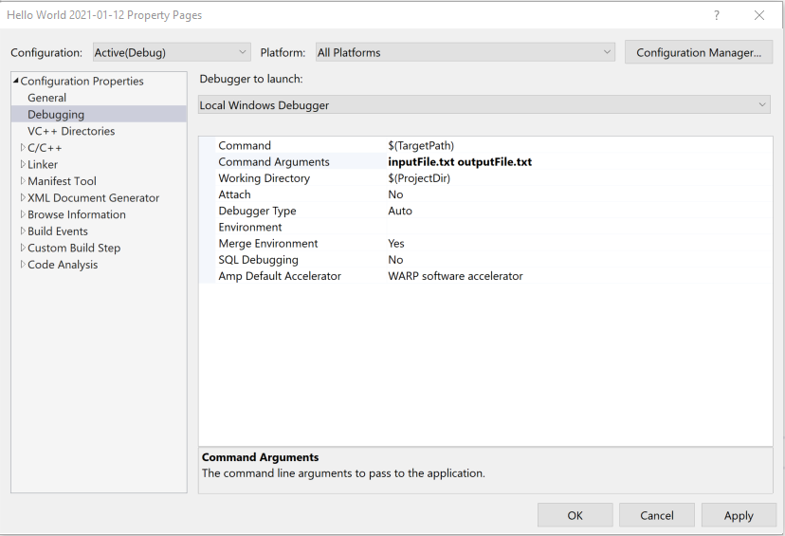
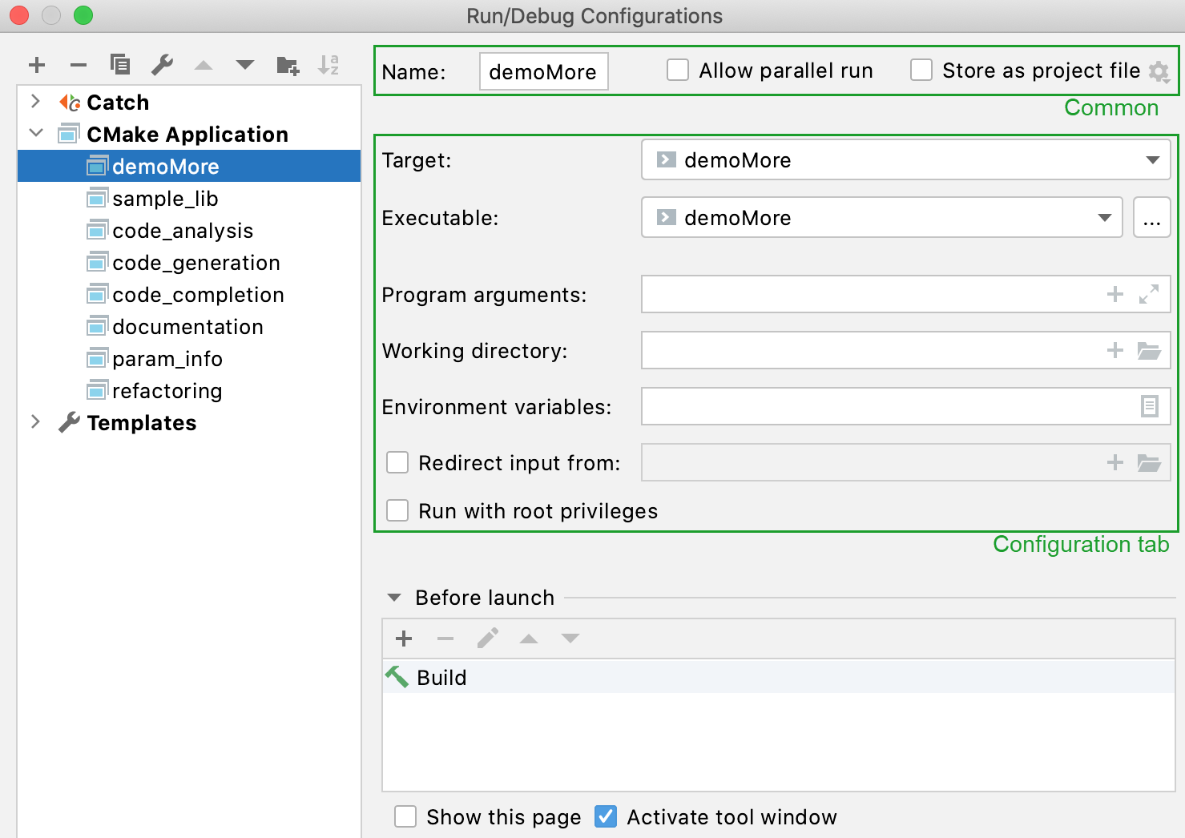
inputFile.txt outputFile.txt

Slide 7
Dynamic Multi-dimensional Arrays
A stack allocated array would be a great object for storing data, but...
C++ does not allow a stack allocated array whose size is not constant.
Stack allocated arrays are l-value contiguous data structures.
Array size MUST be known at compile time.
a[0][0] | a[0][1] | a[0][2] | a[0][3] | a[0][4]
a[1][0] | a[1][1] | a[1][2] | a[1][3] | a[1][4]
a[2][0] | a[2][1] | a[2][2] | a[2][3] | a[2][4]
a[3][0] | a[3][1] | a[3][2] | a[3][3] | a[3][4]
Let's try:
int main(int argc, char* argv[])
{
int rows, cols;
string line = "4 5";
istringstream iss(line);
iss >> rows >> cols;
int a[rows][cols];
a[3][4] = 100;
return 0;
}

Slide 8
Dynamic Multi-dimensional Arrays
A stack allocated array would be a great object for storing data, but...
C++ does not allow a stack allocated array whose size is not constant.
Stack allocated arrays are l-value contiguous data structures.
Array size MUST be known at compile time.
Or this:
int main(int argc, char* argv[])
{
int rows, cols;
string line = "4 5";
istringstream iss(line);
iss >> rows >> cols;
int (*a)[cols] = new int[rows][cols];
a[3][4] = 100;
return 0;
}
error C2440: 'initializing': cannot convert from 'int (*)[1]' to 'int (*)[cols]'

Slide 9
Dynamic Multi-dimensional Arrays
Since C++ does not allow a stack allocated array of variable size, we need to dynamically allocate memory for the array.
Dynamic arrays use pointers.
Memory for a dynamic array comes from the heap.
Consider the following:
int main(int argc, char* argv[])
{
int rows, cols;
string line = "4 5";
istringstream iss(line);
iss >> rows >> cols;
int **a = new int*[rows];
for(int i = 0; i < rows; ++i)
a[i] = new int[cols];
a[3][4] = 100;
return 0;
}
a[0][0] | a[0][1] | a[0][2] | a[0][3] | a[0][4]
a[0]
a[1]
a[2]
a[3]
a[1][0] | a[1][1] | a[1][2] | a[1][3] | a[1][4]
a[2][0] | a[2][1] | a[2][2] | a[2][3] | a[2][4]
a[3][0] | a[3][1] | a[3][2] | a[3][3] | a[3][4]

Slide 10
Lab 01 Questions
Can I store names and scores in the same array?
Why do I have to use dynamic arrays to store input data?
What file is opened for input?
What file is opened for output?
How can I parse the student's full name?
How can I parse student exam scores?
Where do I store student averages?
How are averages output with one digit after the decimal point?
No, use two dynamic arrays.
Yes, the size of the arrays is determined at run time.
argv[1] is the name of the input file.
argv[2] is the name of the output file.
The name ends with the first digit.
Use an istringstream and the extraction operator (>>).
Consider double* averages = new double[num_exams];
Consider out << setw(6) << setprecision(1) << fixed << averages[i];

Slide 11
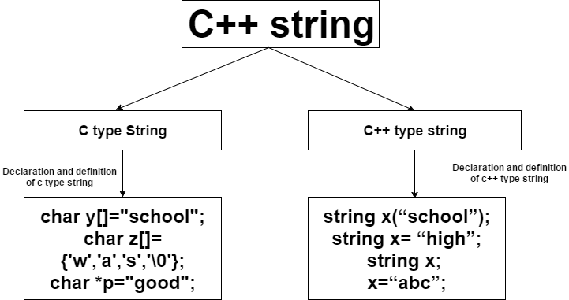
P.8 The string Class
Strings Are Really Templates
P.8 The string Class

Slide 12
Template Classes
A C++ template is literally a template or blueprint for creating a generic class or function of a specified type.
A template is not a class.
Using C++ templates avoids having to write nearly identical classes (int, float, etc.), but results in compiled code that is mostly as if we had written each version separately.
A C++ template uses "Instantiation-style polymorphism.
For example, the template MyClass<T> isn't really a generic class that can be compiled to code.
Only the result of instantiation of the template can be compiled.
The C++ string class is an instantiation of the basic_string class template that uses char (i.e., bytes) as its character type.
Strings are objects that represent sequences of characters.
typedef basic_string<char> string;

Slide 13
Strings vs Character Arrays
Character arrays
Size allocated statically.
More memory cannot be allocated at run time.
Unused allocated memory is wasted.
Strings
Size allocated dynamically.
Memory allocated at run time on demand.
Memory is pre-allocated, no memory is wasted.
Threat of array decay (loss of type and dimensions when passing an array into function by value or pointer).
As strings are represented as objects, no array decay occurs.
std:: string slower with object construction.
Implementations are fast.
String class functions:
Input functions (3),
Capacity functions (3),
Iterator functions (4),
Manipulating functions (2),
and more…
No inbuilt functions to manipulate strings. (string.h library w/strcpy, strcat, strlen, strcmp, …)

Slide 14
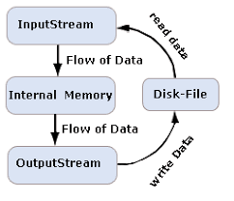
P.9 Input / Output Using Streams
Console Input / Output
Input Streams
Output Streams
Formatting Output Using I/O Manipulators
File Streams
openmode
String Streams
P.9 Input / Output Using Streams

Slide 15
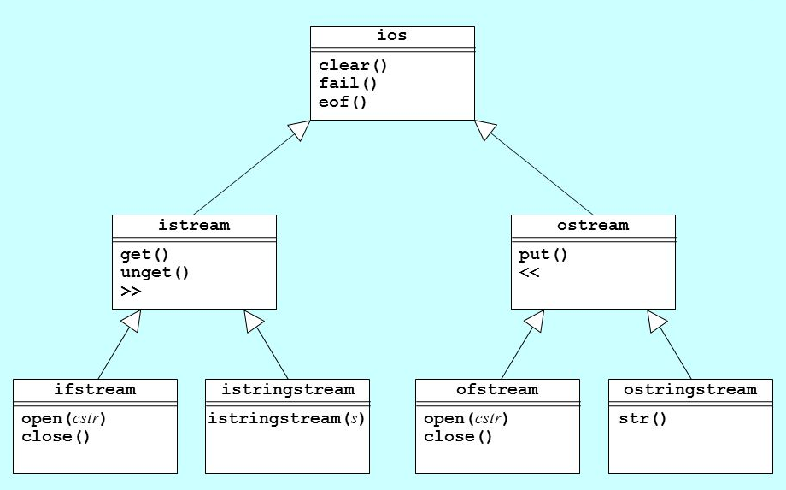
Stream Class Hierarchy
Input
Output

Slide 16
1.1 The Software Life Cycle
Software Life Cycle Models
Software Life Cycle Activities
Requirements Specification
Analysis
Design
1.1 The Software Life Cycle

Slide 17
The Software Life Cycle
The purpose of a typical college course programming assignment is to provide experience with a particular programming concept.
In contrast, an industrial software product is likely to be used over an extended period by individuals other than the creator(s) of the product.
A software product goes through stages called the software life cycle.
Planning
Requirements
Analysis and Design
Implementation
Unit and Integration Testing
Operation and Maintenance.

Slide 18
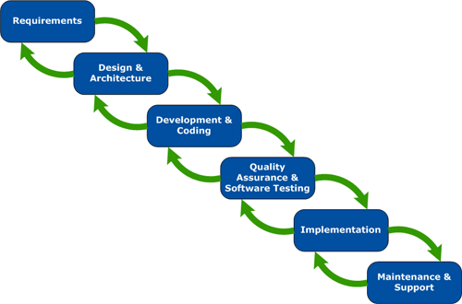
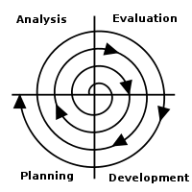
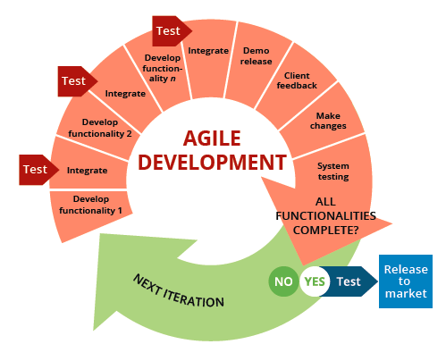
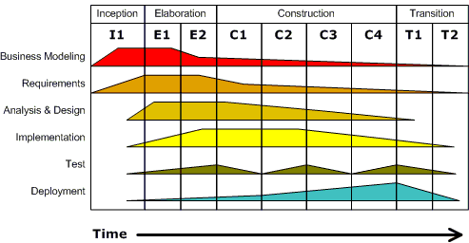
Software Development
Waterfall
Spiral
Extreme
Agile
Unified or Core Flow Model

Slide 19
Object-Oriented Design
Top-down design (also called stepwise refinement) focuses on actions.
Bottom-up design focuses on data elements.
Object-oriented design (OOD) focuses on data and operations together.
First, identify the objects that participate in our problem (whose common characteristics form a class) then
Second, identify how the objects interact to form a solution (the interaction occurs through messages)
And then, provide an operator for each class (usually a function) to process the message.
Looking at the nouns in the problem statement often helps us identify objects; verbs often indicate operators.
OOD is a combination of both top-down and bottom-up design.

Slide 20
1.2 Using Abstraction to Manage Complexity
Procedural Abstraction
Data Abstraction
Information Hiding
1.2 Using Abstraction to Manage Complexity

Slide 21
Abstraction and Information Hiding
Abstraction controls complexity by separating top-level design from lower-level implementation.
Procedural abstraction encapsulates behavior in methods that separate its implementation from its users.
Data abstraction reduces a particular body of data into simplified abstract data types (ADT).
The process of "hiding" class implementation details is called information hiding.
The designer can postpone making decisions regarding the actual internal representation of the data objects and the implementation of its operators.
If the details of a data object's implementation are hidden from the higher-level module (a C++ class), the higher-level class can access the data object only through its member functions.
This is an advantage because it allows internal changes to a function without having to rewrite the higher-level class.

Slide 22
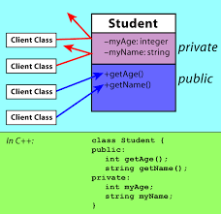
1.3 Defining C++ Classes
Class Definition
The public and private Parts
Class Implementation
Constructors
Modifier and Accessor Member Functions
Operators
Friends
Classes as Components of Other Classes
Array Data Fields
Documentation Style for Classes and Functions
1.3 Defining C++ Classes

Slide 23
Classes
#include <iostream>
#include <string>
#include <sstream>
using namespace std;
class Person
{
private:
string name;
int age;
public:
Person::Person(string name, int age)
{
this->name = name;
this->age = age;
}
string getName() const { return name; }
int getAge() const { return age; }
string toString() const
{
ostringstream out;
out << name << "(" << age << ")";
return out.str();
}
};
A class is a data type and a pattern for creating objects.
A class definition describes the names of the class operations and the internal data contents (the data members).
instance variables - each class instance (object) has its own storage, usually private to hide implementation details.
Member functions (usually public) operate on any object of the class of which it is a member and have access to all the data members of the class object.

Slide 24
Class Access Specifiers
The private access specifier limits access of class members to the class definition.
Control access to an object's data.
Prevent improper use and processing of an object's data.
Allow change of private data representation without effecting programs that use the class.
The public access specifier exposes the public members of the class definition.
The protected access specifier gives access to the public and protected access members of a class to derived classes.
A friend function of a class has the same access privileges to private and protected data as the class member functions.
A friend function is declared by the class that is granting access, so friend functions are part of the class interface, like methods.
Since private members of a class are only accessible from within the class, a friend function must also be declared inside of a class but may be implemented outside of the class.
Even though the prototypes for friend functions appear in the class definition, friends are not member functions.

Slide 25
Friends
#include <iostream>
#include <string>
using namespace std;
class MyClass
{
private:
string name;
public:
MyClass(const string name) { this->name = name; }
~MyClass() = default;
friend ostream& operator<< (ostream& os, const MyClass& me)
{
os << "MyClass(" << me.name << ")";
return os;
}
};
int main(int argc, char* argv[])
{
MyClass me("Suzy Student");
cout << me << endl;
return 0;
}
Each member function has an implicit parameter named this whose value is a pointer to the object with which the member function was called.
Defines an independent insertion operator function that is a friend of MyClass.
The friend insertion operator function has access to MyClass’ private data members.
Returns a reference to the output stream that has been modified.

Slide 26
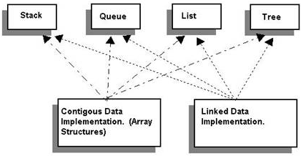
1.4 Abstract Data Types, Interfaces, and Pre- and Post- conditions
Abstract Data Types (ADTs) and Interfaces
Contracts and ADTs
Pre-conditions and Post-conditions
1.4, pgs 98-101

Slide 27
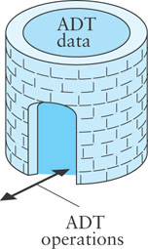
ADTs
An Abstract Data Type (ADT) is a mathematical model for data types.
A C++ class provides one way to implement an ADT.
A user interacts with an ADT thru the class public methods.
An ADT encapsulates data and methods and is a contract between the designer of the class, the implementor of the class, and the programmer who uses the class.
Any programmer who develops or uses an ADT class knows exactly what methods are available in that class and what operations they will perform.
Pre- and post- conditions are part of the contract between a call to a class method and the results of the method call.
A pre-condition is a statement of any assumptions or constraints on the method's input data that are expected to apply before the method is executed.
If a pre-condition is not met, there is no guarantee that the method will do what is expected.
A post-condition is a statement that describes the results after the method completes and returns.
When implementing an ADT, we document the pre-conditions and post-conditions in the documentation comments.

Slide 28
Be Safe

